Slide 1
Review: Fixed-Volume CSTR Start-Up
Isothermal (unusual, but simple case), well-mixed CSTR
Unsteady state: concentrations vary with time & accumulation is non-zero
Goal: Determine the time required to reach steady-state operation and C_{A} as a function of time
-
In
Out
+
Generation
Accumulation
C_{A0}υ₀
υ₀C_{A}
=
moles A in CSTR Δ wrt time while in unsteady state
Use concentration rather than conversion in the balance eqs
Integrate to find C_{A} (t) while CSTR of 1st order rxn is in unsteady-state:

Slide 2
Review: Time to Reach Steady-State
At steady state, t is large and:
0
In the unsteady state, when C_{A} = 0.99C_{AS}:
time to reach 99% (C_{A} = 0.99C_{AS}) of steady-state concentration in terms of τk
When k is very small (slow rxn), 1>>τk:
When k is very big (fast rxn), 1<<τk
63% of the steady-state concentration is achieved at:
C_{A} = 0.63C_{AS}
99% of the steady-state concentration is achieved at:

Slide 3
Review: Enhanced Yield in Semi-Batch Reactor
Semi-batch
F_{D}
F_{B}
A
A+B
A+B→P
A+B⇌C+D
V₀ + υ₀t
V₀
V₀ + υ₀t
V₀ - υ₀t
V_{f}
Scenario 1 shown in blue. Scenario 2 shown in red.
Scenario 1: Enhance selectivity of desired product over undesired side product
Higher concentrations of A favor formation of the desired product
Higher concentrations of B favor formation of the undesired side product
Scenario 2: Improve the product yield obtained from a reversible reaction
Allowing D(g) to bubble out of solution pushes equilibrium towards completion

Slide 4
Review: Mole Balance on A for Semi-Batch Reactor
C_{B}υ₀
Goal: Find how C_{A} Δ with time (assume reactor is well-mixed)
-
In
Out
+
Generation
=
Accumulation
Use whatever units are most convenient (N_{A}, C_{A}, X_{A}, etc)
V₀ + υ₀t
Convert N_{A} to C_{A} using:
Reactor volume balance:
-
In
Out
+
Generation
=
Accumulation
= υ₀
ρ = ρ₀
Rearrange to get in terms of dC_{A}/dt

Slide 5
Review: Mole Balance on B in Semi-Batch Reactor
C_{B}υ₀
Goal: Find how C_{B} Δ with time (assume reactor is well-mixed)
Mole balance on B:
-
In
Out
+
Generation
=
Accumulation
V₀ + υ₀t
Substitute
Rearrange to get in terms of dC_{B}/dt
Balance on B

Slide 6
Review: Semi-Batch Mole Balances in Terms of N_{A}
C_{B}υ₀
Goal: Find how N_{A} & N_{B} Δ with time (reactor is well-mixed)
-
In
Out
+
Generation
=
Accumulation
V₀ + υ₀t
Substitute: -r_{A} = k_{A}C_{A}C_{B} and
N_{B} comes from basic mole balance:
The design eq in terms of X_{A} can be messy. Sometimes it gives a single equation when using N_{j} or C_{j} gives multiple reactor designs

Slide 7
What conversion and P is measured at the outlet of the PBR? The rxn is isothermal at 300 K, assume ideal gas behavior, and the feed contains pure A (g).
X=0
P₀ = 20 atm
X=?
P = ? atm
PBR, 1000 kg cat
2A→B -r_{A} = kC_{A}² α = 0.0008/kg
k=0.1 dm⁶/mol∙min∙kg cat at 300 K
F_{A0} = 10 mol min
Mole balance
Rate law
Stoichiometry (put C_{A} in terms of X)
Combine
Relate P/P₀ to W
1

Slide 8
What conversion and P is measured at the outlet of the PBR? The rxn is isothermal at 300 K, assume ideal gas behavior, and the feed contains pure A (g).
X=0
P₀ = 20 atm
X=?
P = ? atm
PBR, 1000 kg cat
2A→B -r_{A} = kC_{A}² α = 0.0008/kg
k=0.1 dm⁶/mol∙min∙kg cat at 300 K
F_{A0} = 10 mol min
Combine
Relate P/P₀ to W
Simultaneously solve dX_{A}/dW and dP/dW (or dy/dW) using Polymath
First, need to determine ε, C_{A0}, & υ₀.
What is C_{A0}?

Slide 9
What conversion and P is measured at the outlet of the PBR? The rxn is isothermal at 300 K, assume ideal gas behavior, and the feed contains pure A (g).
X=0
P₀ = 20 atm
X=?
P = ? atm
PBR, 1000 kg cat
2A→B -r_{A} = kC_{A}² α = 0.0008/kg
k=0.1 dm⁶/mol∙min∙kg cat at 300 K
F_{A0} = 10 mol min
Combine
Relate P/P₀ to W
Simultaneously solve dX_{A}/dW and dP/dW (or dy/dW) using Polymath
First, need to determine ε, C_{A0}, & υ₀.
What is C_{A0}?

Slide 10
What conversion and P is measured at the outlet of the PBR? The rxn is isothermal at 300 K, assume ideal gas behavior, and the feed contains pure A (g).
X=0
P₀ = 20 atm
X=?
P = ? atm
PBR, 1000 kg cat
2A→B -r_{A} = kC_{A}² α = 0.0008/kg
k=0.1 dm⁶/mol∙min∙kg cat at 300 K
F_{A0} = 10 mol min
Simultaneously solve dX_{A}/dW and dP/dW (or dy/dW) using Polymath

Slide 11
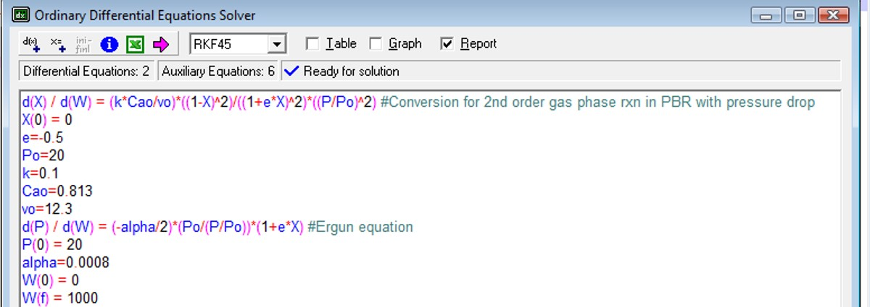
What conversion and P is measured at the outlet of the PBR? The rxn is isothermal at 300 K, assume ideal gas behavior, and the feed contains pure A (g).
X=0
P₀ = 20 atm
X=?
P = ? atm
PBR, 1000 kg cat
2A→B -r_{A} = kC_{A}² α = 0.0008/kg
k=0.1 dm⁶/mol∙min∙kg cat at 300 K
F_{A0} = 10 mol min
Simultaneously solve dX_{A}/dW and dP/dW (or dy/dW) using Polymath

Slide 12
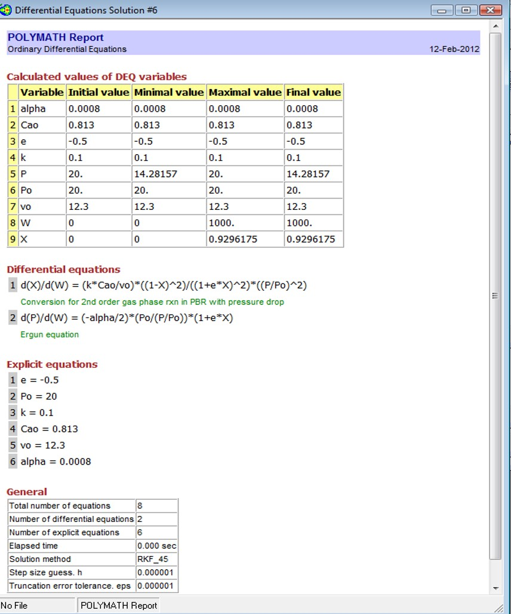
What conversion and P is measured at the outlet of the PBR? The rxn is isothermal at 300 K, assume ideal gas behavior, and the feed contains pure A (g).
P = 14.28 atm
X = 0.93

Slide 13
What conversion can be achieved in a fluidized CSTR with the same catalyst weight and P₀ = P (ideal gas behavior, pure A feed)?
Use info from PBR to determine F_{A0}, C_{A0} & k
Do not plug in P and P₀ that occurred in PBR yet! Use Ergun eq to get P/P₀ as a function of W, plug into design eq & integrate over W!
0
1
Use PBR expt parameters to solve for α
Isothermal and ε=0. Ergun eq for P/P₀ becomes:
Plug into C_{A}:

Slide 14
What conversion can be achieved in a fluidized CSTR with the same catalyst weight and P₀ = P (ideal gas behavior, pure A feed)?
Use info from PBR to determine F_{A0}, C_{A0} & k
Plug C_{A} into PBR design eq:
Rearrange
Integrate so that we can get values of unknowns

Slide 15
What conversion can be achieved in a fluidized CSTR with the same catalyst weight and P₀ = P (ideal gas behavior, pure A feed)?

Slide 16
What conversion can be achieved in a fluidized CSTR with the same catalyst weight and P₀ = P (ideal gas behavior, pure A feed)?
Plug this value into the CSTR eq

Slide 17
What conversion can be achieved in a fluidized CSTR with the same catalyst weight and P₀ = P (ideal gas behavior, pure A feed)?
Conversion in fluidized CSTR, no pressure drop

Slide 18
A + 2B → C Elementary rxn, feed is a stoichiometric mixture
Fluidized CSTR, isothermal, isobaric, ideal, gas-phase reaction
P₀= 6 atm; T = 443K & υ₀ = 50 dm³/min
How many kg of catalyst is required to achieve X_{A} = 0.8?
Fluidized CSTR design eq:
Known: υ₀ and X_{A}
Unknown: C_{A0} & -r’_{A}
1. What is C_{A0}?
Feed is a stoichiometric mixture → 1 part A, 2 parts B

Slide 19
A + 2B → C Elementary rxn, feed is a stoichiometric mixture
Fluidized CSTR, isothermal, isobaric, ideal, gas-phase reaction
P₀= 6 atm; T = 443K & υ₀ = 50 dm³/min
How many kg of catalyst is required to achieve X_{A} = 0.8?
Known: υ₀, X_{A}, & C_{A0} (0.055 mol/dm³)
Unknown: -r’_{A}
Express rate law in terms of partial pressure, not C_{j}
2. What is –r’_{A}?
2a. What is P_{A}?
For ideal, isobaric, isothermal rxn:
Substitute for C_{j} & C_{j0}

Slide 20
A + 2B → C Elementary rxn, feed is a stoichiometric mixture
Fluidized CSTR, isothermal, isobaric, ideal, gas-phase reaction
P₀= 6 atm; T = 443K & υ₀ = 50 dm³/min
How many kg of catalyst is required to achieve X_{A} = 0.8?
Known: υ₀, X_{A}, & C_{A0} (0.055 mol/dm³)
Unknown: -r’_{A}
Units on k necessitate expressing rate law in terms of partial pressure, not C_{j}
2. What is –r’_{A}?
2a. What is P_{A}?
ν_{A}=-1 Θ_{A}=1

Slide 21
A + 2B → C Elementary rxn, feed is a stoichiometric mixture
Fluidized CSTR, isothermal, isobaric, ideal, gas-phase reaction
P₀= 6 atm; T = 443K & υ₀ = 50 dm³/min
How many kg of catalyst is required to achieve X_{A} = 0.8?
Known: υ₀, X_{A}, & C_{A0} (0.055 mol/dm³)
Unknown: -r’_{A}
2. What is –r’_{A}?
2b. What is P_{B}?
ν_{B}=-2

Slide 22
A + 2B → C Elementary rxn, feed is a stoichiometric mixture
Fluidized CSTR, isothermal, isobaric, ideal, gas-phase reaction
P₀= 6 atm; T = 443K & υ₀ = 50 dm³/min
How many kg of catalyst is required to achieve X_{A} = 0.8?
Known: υ₀, X_{A}, & C_{A0} (0.055 mol/dm³)
Unknown: -r’_{A}
2. What is –r’_{A}?
2c. What is k at 443K?

Slide 23
A + 2B → C Elementary rxn, feed is a stoichiometric mixture
Fluidized CSTR, isothermal, isobaric, ideal, gas-phase reaction
P₀= 6 atm; T = 443K & υ₀ = 50 dm³/min
How many kg of catalyst is required to achieve X_{A} = 0.8?
Known: υ₀, X_{A}, & C_{A0} (0.055 mol/dm³)
Unknown: -r’_{A}
2. What is –r’_{A}?

Slide 24
A + 2B → C Elementary rxn, feed is a stoichiometric mixture
Fluidized CSTR, isothermal, isobaric, ideal, gas-phase reaction
P₀= 6 atm; T = 443K & υ₀ = 50 dm³/min
How many kg of catalyst is required to achieve X_{A} = 0.8?
C_{A0} =0.055 mol/dm³

